Slide 1
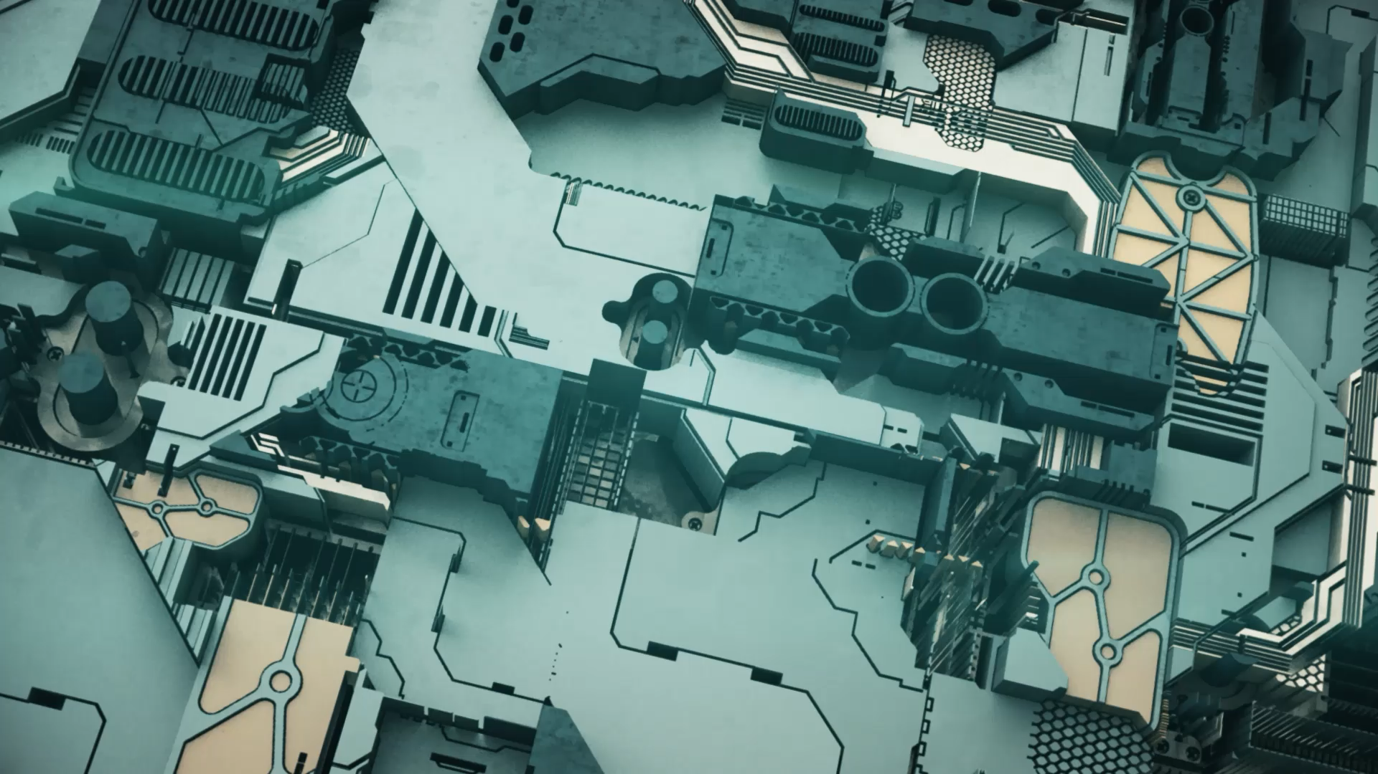
PCB DESIGN
Sepideh Mohammadi, PhD in Computer Science

Slide 2
What is a Printed Circuit Board (PCB)?
PCBs are the internal components that transmit electrical signals through electronic devices.
If electricity is the lifeblood of electronics, printed circuit boards are the vital internal organs.

Slide 3
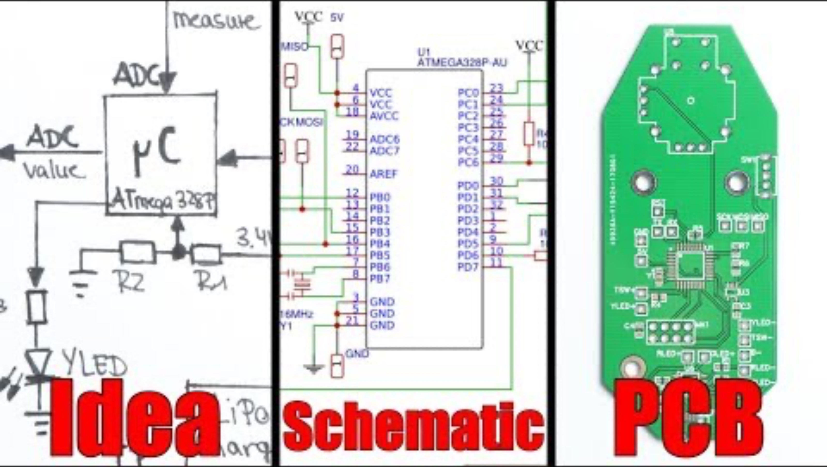

Slide 4
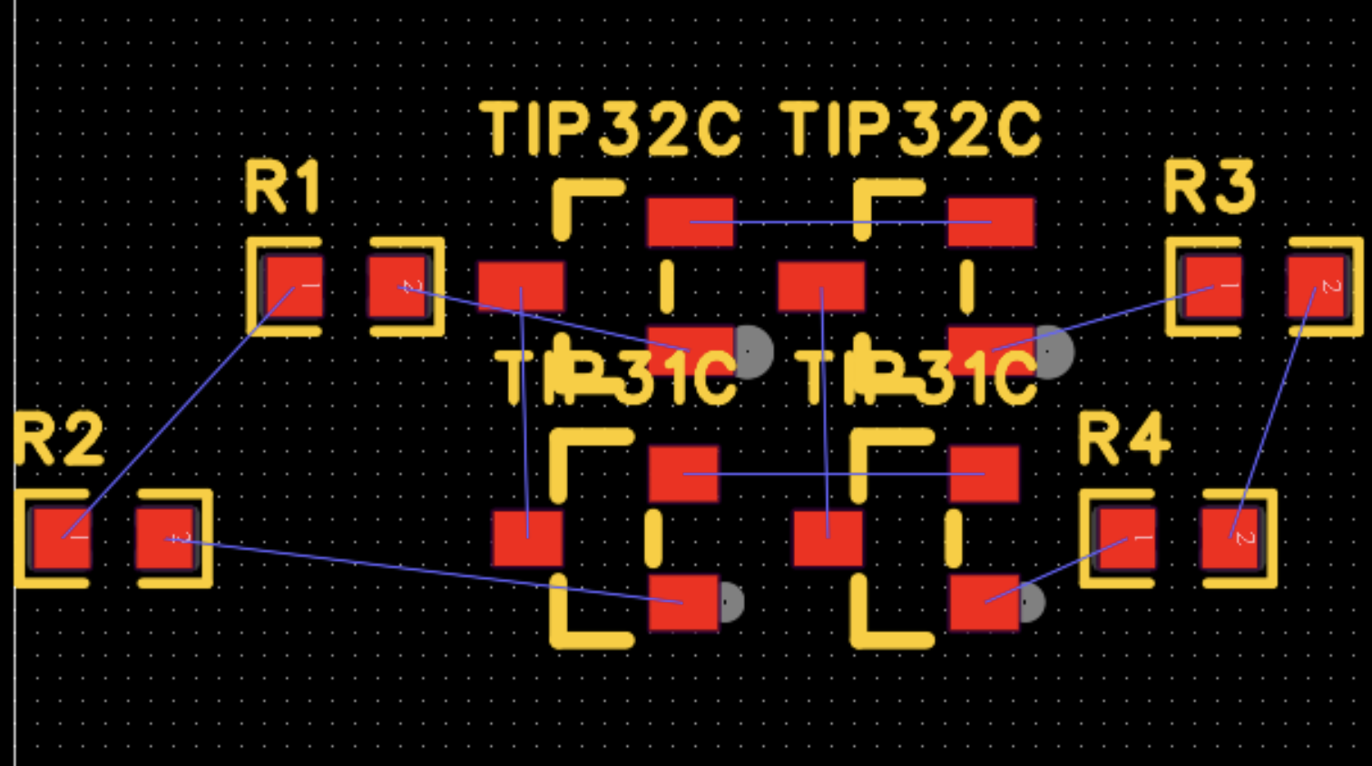
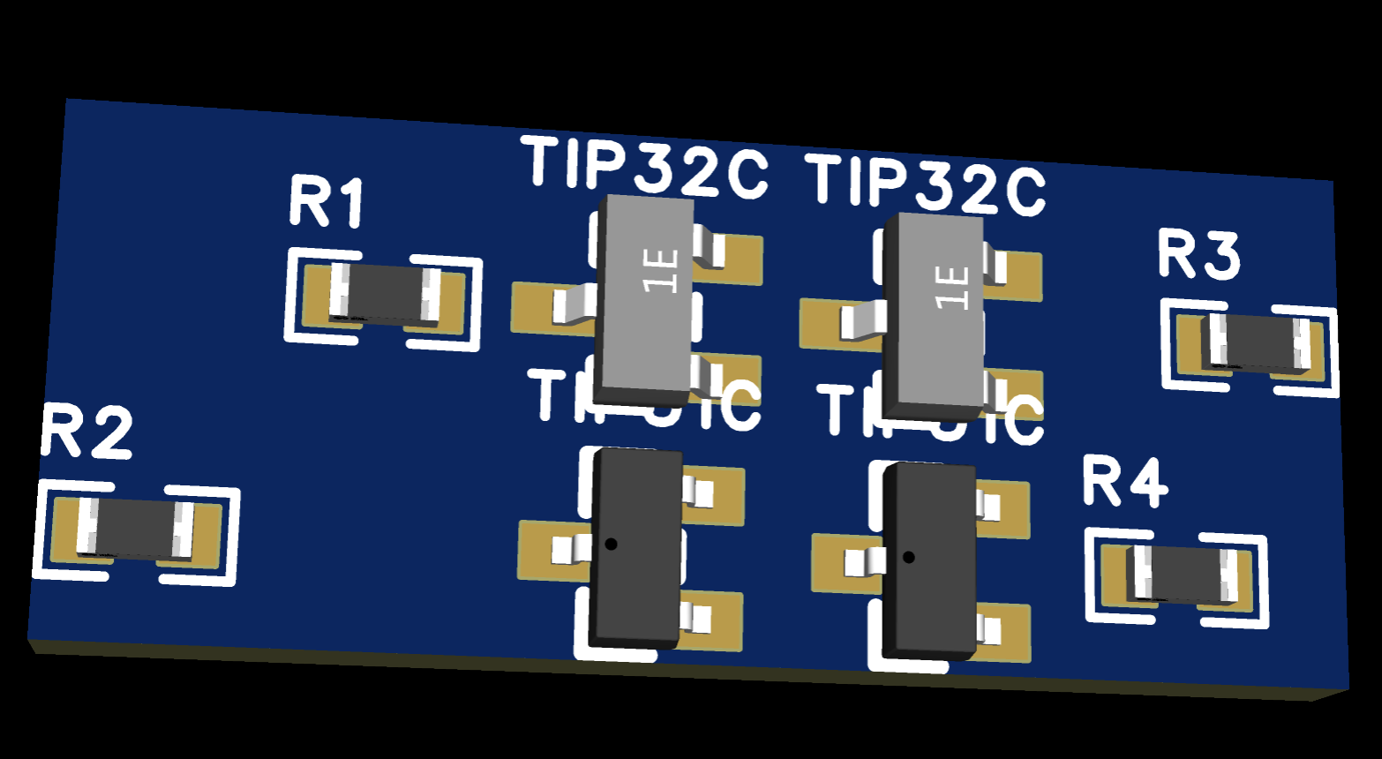
How to design a PCB boards?
Step 1: Design the Schematic Create a circuit diagram showing all components and their connections
Step 2: Convert to PCB Layout Place components on a virtual board, connect traces, and ensure proper spacing
Step 3: Manufacture the Board Send Gerber files to a PCB manufacturer or create the board manually (e.g., etching)
Step 4: Assemble Components Solder components onto the board and test the circuit

Slide 5




Software for PCB Design?
Which Companies Manufacture PCBs?

Slide 6

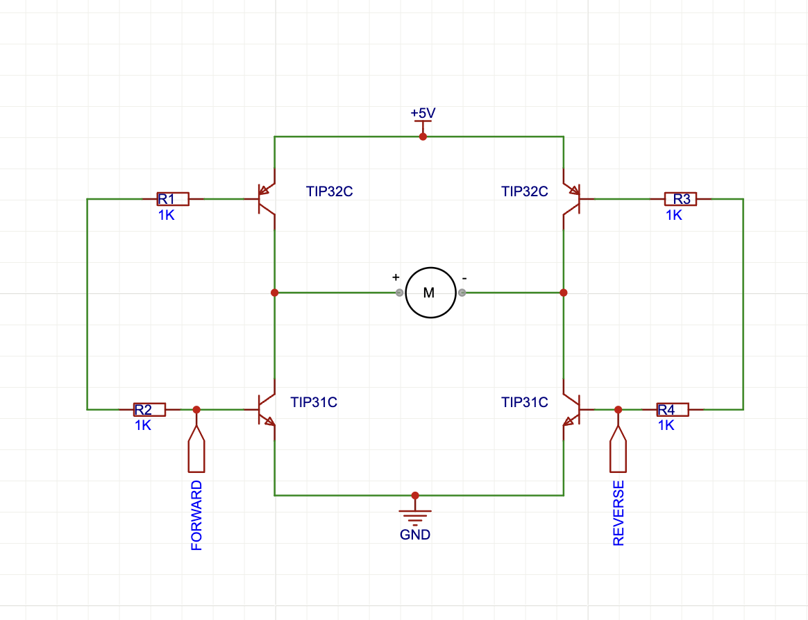
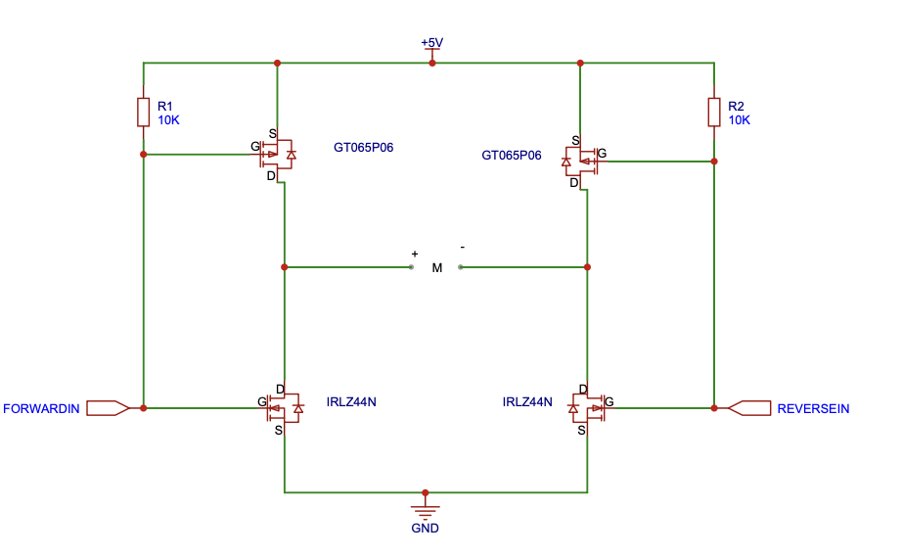
What about today?
Design a H-Bridge circuit to control a motor
Step 1: Drawing Schematics in EASYEDA
Add components, connect with wires
Step 2: Build on a Breadboard
Assemble the circuit on a breadboard to test its functionality and ensure it works
Step 3: Solder Components
Install and solder the tested components onto the etched PCB.
Step 4: Test the Final Board
Check the soldered PCB for functionality and troubleshoot if needed
Notes:
An H-bridge is a simple circuit that lets you control a DC motor to go backward or forward.
You normally use it with a microcontroller, such as an Arduino, to control motors.
When you can control two motors to go either forward or backward – you can build yourself a robot!

Slide 7
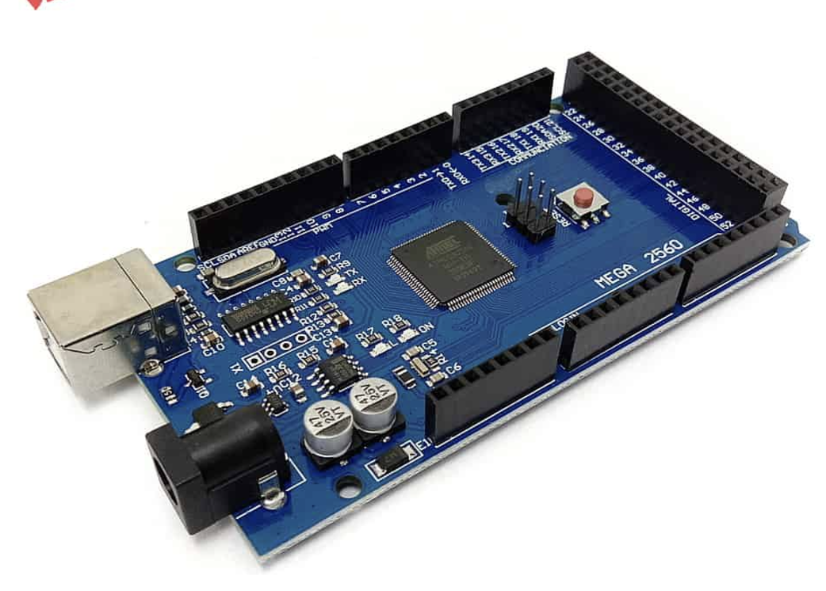
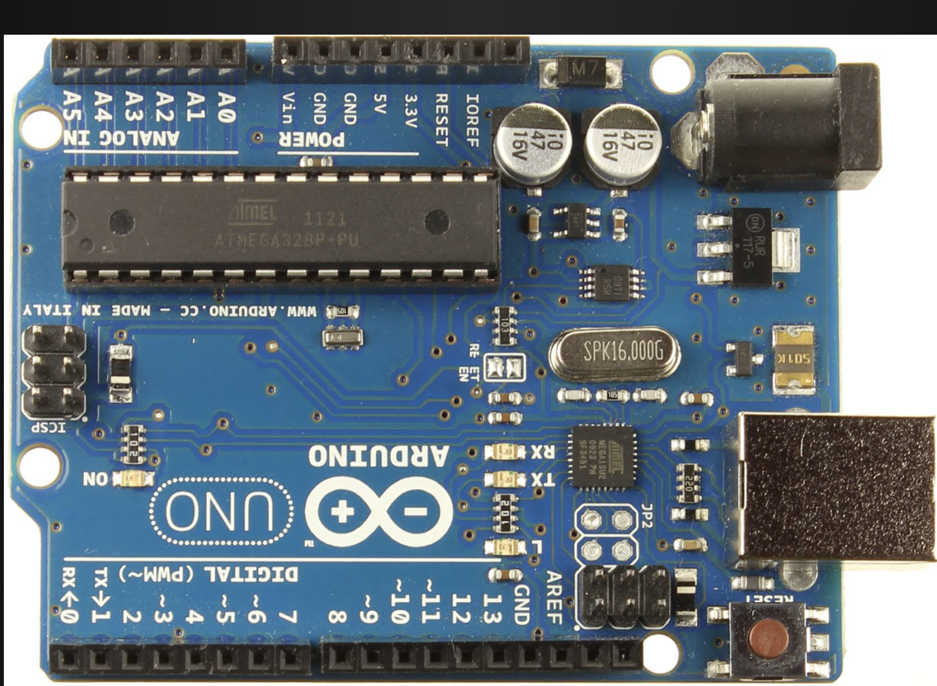
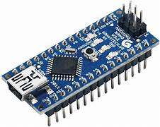
CONNECT TO ARDUINO?
Step 1: INSTALL the Arduino IDE
Step 2: D7 pin connect to Forward in CIRCUIT
Step 3: D5 pin connect to Reverse in
CIRCUIT
Step 4: GND to ground

Slide 8
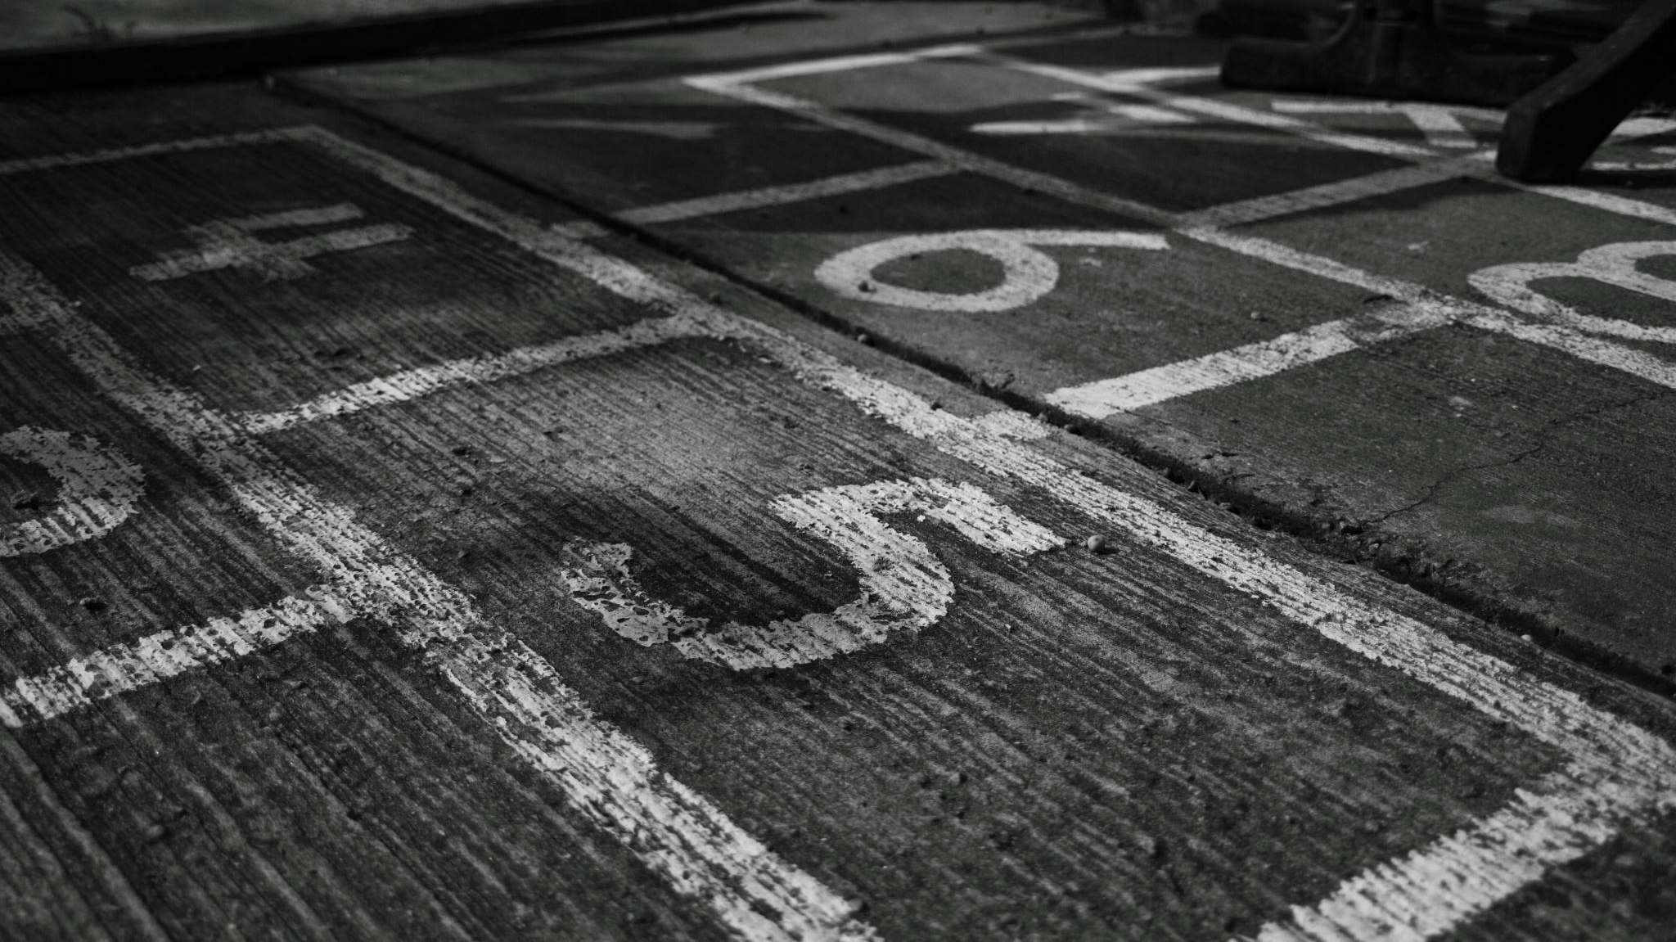


END

